Slide 1
Dreams, Dreaming and the Subconscious

Slide 2
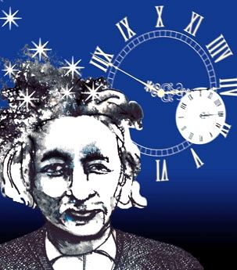
Einstein’s Dreams
A novel by Alan Lightman, MIT author and physicist

Slide 3
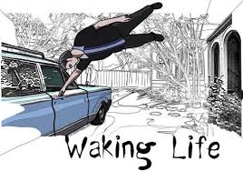
Are you a dreamer?
No one does it anymore.
No one teaches it any more.
Dream with our hands. Dream with our minds.
https://www.youtube.com/watch?v=gavt1AbNcvc
https://www.youtube.com/watch?v=T2NRZ6uS9ws&t=19s

Slide 4
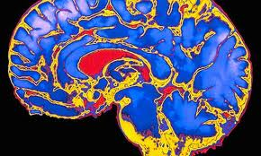
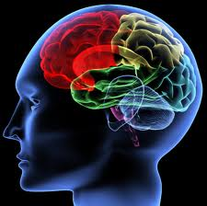
“You have been entrusted with the care and feeding of the most extraordinary and complex creation in the universe.
Home to your mind and personality, your brain houses your cherished memories and future hopes.
It orchestrates the symphony of consciousness that gives you purpose and passion, motion and emotion.”
But what do you really know about it ?
(Quote from Franklin Institute for Science Learning)
Notes:
http://www.quantumconsciousness.org/presentations/whatisconsciousness.html

Slide 5
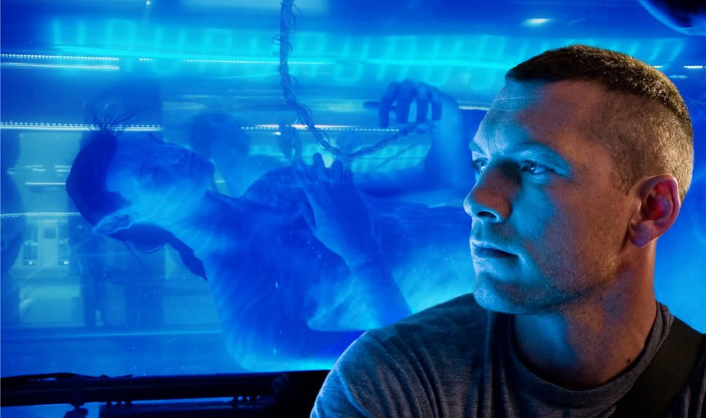
Who is the real Jake Sully?
Critical Thinking Questions:
is the mind part of the brain and body?
If they are distinct, how do they interact?
Does the answer change the way we learn, engineer robots or design tech? Should robots have the same rights as humans?
In what ways does this change or affect identity and the idea of who you are and how you got to be that way?
How vast is the mind?
Is there a collective mind?
If some of our brain is not active when we’re dreaming, and our body is paralyzed, do we become less connected to our body and identify more with our mind?

Slide 6
Marc Chagall Cow with a Parasol
Cows have different meanings to different people, in different cultures.
Any image will have a different meaning depending on the dreamer and the context.

Slide 7
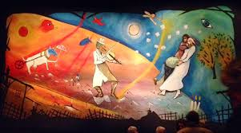
Curtain, inspired by Chagall, for theatre performance of Fiddler on the Roof

Slide 9
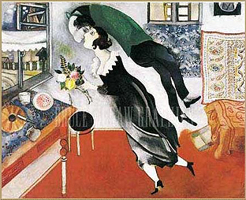
Sometimes we’re so happy we feel like we’re floating on air, like being in a dream

Slide 10
Marc Chagall His paintings have a few distinct images in an unlikely association that would be bizarre in real life, but typical of images we see in dreams. His spontaneity and ability to express a dream-world is why his work is so loved

Slide 11
Left Brain Right, Brain or a Genius!

Slide 12
individuation
http://scienceblogs.com/cognitivedaily/2008/10/casual_fridays_tk421_why_cant.php
http://www.procreo.jp/labo/labo13.html
http://www.dailymail.co.uk/sciencetech/article-4052708/Which-way-think-dancer-spinning-Researchers-explain-latest-hit-optical-illusion-genius.html

Slide 13
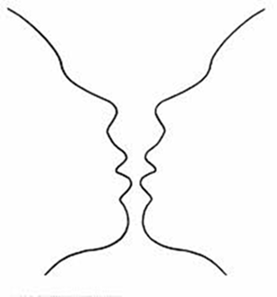
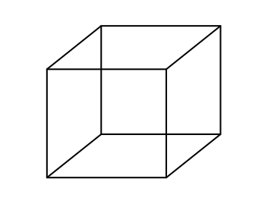
Bistable Perception /Multistable Perception
Rubin face-vase illusion
Necker Cube
The images are bistable perceptions, in which the brain spontaneously
switches between two interpretations of the same ambiguous stimulus

Slide 14
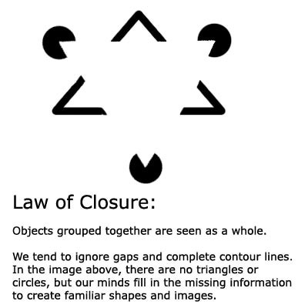
Gestalt Laws of Perceptual Organization
Our brains ignore contradictory information and fill gaps in with information.
Gestalt Psychology:
The whole is greater than the sum of its parts
Confabulation: (Psychology ) To fill gaps in one's memory with fabrications that you believe to be facts.
Notes:
Gestalt Psychology: The whole is greater than the sum of its parts

Slide 15
what’s MISSING ? YOUR PERSPECTIVE of the horizon

Slide 16
Gestalt
Confabulation: (Psychology ) To fill gaps in one's memory with fabrications that you believe to be facts.

Slide 17
POP-PSYCHOLOGY and myths
We only use 10% of our brain
That we’re left brain or right brain thinkers

Slide 18
The Split-Brain (Gazzaniga & Sperry at Cal-Tech)
Wins a Nobel Prize 1981
4 minutes Dr. Gazzinga https://www.youtube.com/watch?v=ZMLzP1VCANo
7+ minutes Alan Alda Dartmouth Campus
https://www.youtube.com/watch?v=lfGwsAdS9Dc

Slide 19
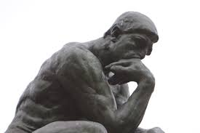
The left hand doesn’t know what the right hand is doing?
Dr. Gazziniga won a Nobel Prize for his research on split-brains.
He concludes that a final stage pulls information together and connects it with the past- what we already know- and in this way we generate explanations and create a story, including our life story
A major founder of the field of Cognitive Neuroscience
director of the SAGE Center for the Study of the Mind at the University of California
http://bigthink.com/videos/your-storytelling-brain-2
http://bigthink.com/users/michaelgazzaniga

Slide 20
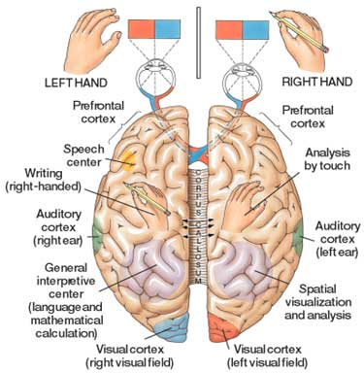

Slide 21
Split-Brains
Dr. Gazzaniga:
“The brain isn't like a computer, with specific sections of hardware charged with specific tasks. It's more like a network of computers connected by very big, busy broadband cables. The connectivity between active brain regions is turning out to be just as important, if not more so, than the operation of the distinct parts.”
Experiments have shown:
It was commonly believed that the left brain is analytic and the right brain is artistic but fMRIs shows that specialized tasks engage networks across the entire brain
That each half of the brain can function independently
That while each brain can act independently, with communication they can work together
That each half of the brain can compensate for the other half
Independent Brains: https://www.youtube.com/watch?v=lfGwsAdS9Dc
Dr. Gazzaniga talks about the story we create:
https://www.youtube.com/watch?v=ZMLzP1VCANo

Slide 22
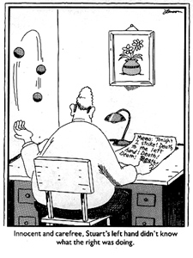
Neuropsychology: Left Brain Narrative (The Interpreter)
similar to the theories of Psychology theory of Confabulation
and the Gestalt idea of completion
The interpreter in our left hemisphere
constructs a story about why we act the way we do
constructs our conscious reality
conscious life is a (constructed) "afterthought"
Thousands/millions of brain activities are relatively independent of independent of one another
outside the realm of conscious experience.
they affect body movements, emotions, thoughts, ....
However, once the brain activity is expressed, the expressions become events that the conscious system takes note of and that the interpreter must explain.

Slide 23
Dr. Michael S. Gazzaniga: Hmmm.
Who’s driving the submarine?
https://youtu.be/FZLIcQf47TQ
Notes:
Beatle’s yellow Submarine
https://www.youtube.com/watch?v=lWSjZjagMfk

Slide 24
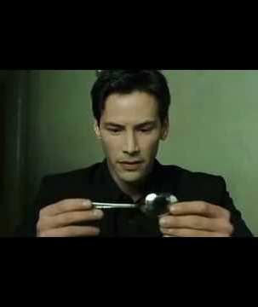
Is it possible to share thoughts? Can we share dreams?
Notes:
The Matrix

Slide 26
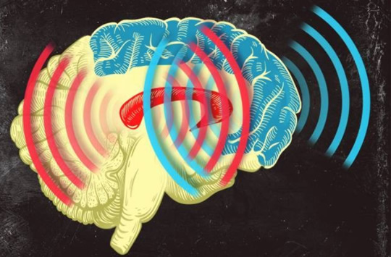
Synchronized Brain Waves enable rapid learning; new research 2014
Professor Earl K. Miller, MIT neuroscientist,
“If you can change your thoughts from moment to moment, you can’t be doing it by constantly making new connections and breaking them apart in your brain. Plasticity doesn’t happen on that kind of time scale.
There’s got to be some way of dynamically establishing circuits to correspond to the thoughts we’re having in this moment, and then if we change our minds a moment later, those circuits break apart somehow.” Category-learning results in new functional circuits between these two areas, and these functional circuits are rhythm-based…
When learning, the brain produces beta waves.
The striatum activates first, sees the pieces of the puzzle, then the prefrontal cortex puts the pieces together, working in sync with the striatum.
Prefrontal Cortex (blue)
& the Central Executive
Striatum (red)
Memory formation
Notes:
When learning, the brain produces beta waves. The striatum activates first, sees the pieces of the puzzle, then the prefrontal cortex acts and puts the pieces together, working in sync with the striatum. Category-learning results in new functional circuits between these two areas, and these functional circuits are rhythm-based,

Slide 27
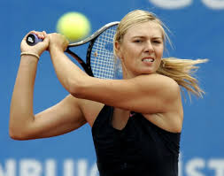
Coma patients

Slide 28
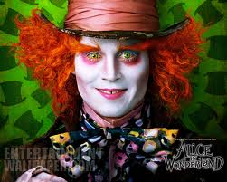
MRI: your brain watching a movie
Avatar
http://www.youtube.com/watch?v=KSKIkXvqruI&list=UUbDdmTlTwoCUx2p7nScbUCw&index=4&feature=plcp
Alice in Wonderland https://www.youtube.com/watch?v=1BWWkXdOui4&index=5&list=UUbDdmTlTwoCUx2p7nScbUCw

Slide 29
Coma means deep sleep-
but is it deep sleep?
Notes:
For a patient to maintain consciousness, two important neurological components must function.
The first is the cerebral cortex—the gray matter that covers the outer layer of the brain.
The other is a structure located in the brainstem, called reticular activating

Slide 30
Coma derives from the ancient Greek word for sleep
Coma is when a comatose person lies unmoving, except for shallow breathing, indefinitely.
People can be in comas for a few hours up to years.
They appear dead to the outside world, except upon close inspection.
Usually caused by trauma or brain injury
When there is healing it’s a slow process
Coma patients do not have the same signs as a person who’s asleep
EEG is not consistent with sleep
Cannot be woken up- Medical intervention is required to maintain life (nutrients intravenously)
There have been recent cases where a coma patients can actually hear and remember things people say to them when they are in the coma.
Notes:
For a patient to maintain consciousness, two important neurological components must function.
The first is the cerebral cortex—the gray matter that covers the outer layer of the brain.
The other is a structure located in the brainstem, called reticular activating

Slide 31
MRI: your brain watching a movie
Harry Potter
https://www.youtube.com/watch?v=7yjHiVfMSHk&list=UUbDdmTlTwoCUx2p7nScbUCw&index=10
Avatar
http://www.youtube.com/watch?v=KSKIkXvqruI&list=UUbDdmTlTwoCUx2p7nScbUCw&index=4&feature=plcp
Alice in Wonderland https://www.youtube.com/watch?v=1BWWkXdOui4&index=5&list=UUbDdmTlTwoCUx2p7nScbUCw

Slide 32
If a tree falls in the forest, does it make a sound?

Slide 33
If a tree falls in your dream, why does it make a sound?

Slide 34
MEMORY
Stages of memory
Encoding
Storage
Retrieval
Kinds of Memory
Short-term memory
Working memory
Long-term memory (Explicit and implicit)
Systems for Consolidation
Synaptic consolidation (within minutes)
Systems consolidation (while we’re sleeping)
Updating and Reconsolidation (weeks, even years later)

Slide 35
Where the wild things are
https://www.youtube.com/watch?v=uNJPSc_4RCI
http://www.traileraddict.com/trailer/where-the-wild-things-are/feature-trailer

Slide 36
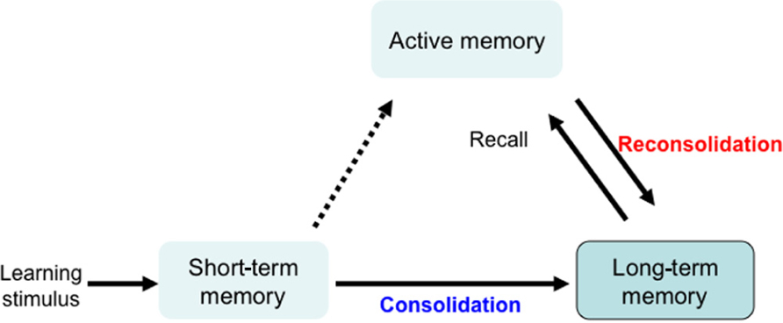
Memory Systems
Synaptic consolidation- within a few hours of learning
(when awake)
Systems consolidation- over days, weeks, maybe months
(when we’re asleep)
Even years later
Memory reconsolidation and Updating consolidation

Slide 37
MEMORY
WHAT KIND OF MEMORY DO WE HAVE?

Slide 38
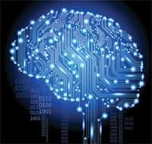
Memory
3 kinds of memory and memory systems:
Short term- active memory
7 things
7 seconds – 30 seconds
Long term- is stored memory
About 86 billion neurons in a brain
Sensory- from senses and experiences
Muscle memory
Explicit (declarative) Conscious
Implicit (procedural) Subconscious
Memory is:

Slide 39
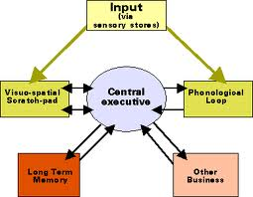
Memory
Working Memory
Central Executive, Prefrontal lateral cortex (PFC)
WM includes Short Term Memory
Attention
But not all memory goes
to long term Memory
Some memories are never in dreams- can you guess why??

Slide 41
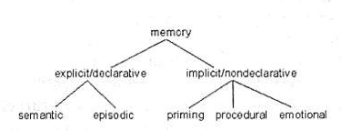
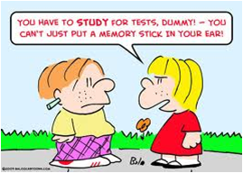
EXPLICIT MEMORY IS CONSCIOUS:
Explicit Memory is the deliberate recollection of a memory; we have to work to remember it. It’s specific, the kind of memory we think about or draw upon countless times a day
Episodic (long-term)
Specific
Autobiographical
Emotional
Includes flashbulb memory
Semantic (long term)
General knowledge
Not unique to individual

Slide 42
Explicit Memory/Declarative
Declarative Memory: information you consciously recall and can explain
Episodic (long-term)
Long term memories of specific events, Specific
Autobiographical
Emotional
Includes flashbulb memory
such as when you won a championship, got your license, broke your arm
Semantic (long term)
Memories of facts, concepts, names, and other general information.
General knowledge..
Not unique to individual
The sky is blue. Grass is green. Crayons come in many colors

Slide 43
Implicit Memory/nondeclarative
Things that we don't purposely try to remember are implicit
both unconscious and unintentional.
sometimes referred to as nondeclarative memory because you are not able to consciously bring it into awareness
PRIMING:
If I wear Nike sneakers I can run faster
Pit bulls are dangerous dogs
Coke is better than Pepsi
PROCEDURAL:
Riding a bicycle
Making toast
EMOTIONAL:
I run into the house when I see a coyote
I jump up and clap and act crazy when Gronk scores a touchdown

Slide 44
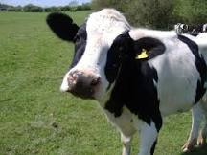
Dreams include images and memories
Episodic Memory
Memories which are actually perceived and known;
Specific
Autobiographical
Emotional, such as love, fear
Includes flashbulb memory
Procedural memory
Procedural is the steps to doing something, or learning to do it
Procedural memory includes muscle memory (how to play piano)
Semantics
general knowledge, NOT unique to individual
symbols and meanings that the symbol emotes
long term memory and implicit
Perceptual memory
Conceptual memory
Abstract
Notes:
1. Episodic
Memories which are actually perceived and known;
For Ex: An actual memory of riding your bike to school
the day you almost got hit by a car. A distinct memory/event
2. Procedural memory
Procedural is the steps to doing something, or learning to do it; Learning How to ride a bike
3. Semantics
Semantics are long term memory;
it is the symbols and meanings that the symbol emotes (with a feeling), or connects in general to something, but not an actual specific experience or a specific thing.
Semantics are general knowledge
Dreams are filled with metaphors and semantics mixed in with episodic memory and learning
Think of everything we put into our brain, (some of it is your thoughts and some is not. Some is nonsense and some is not) and then think about what ends up in your dreams)

Slide 45
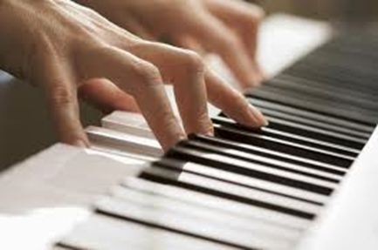
Clive Waring
He has no short-term memory but has implicit memory
Examples of fluctuating between two states of mind,
of being in another state of mind- (in the zone)- & in a 7 second state of awareness
https://www.youtube.com/watch?v=Vwigmktix2Y
His wife’s explanation of his passions https://www.youtube.com/watch?v=ymEn_YxZqZw

Slide 46
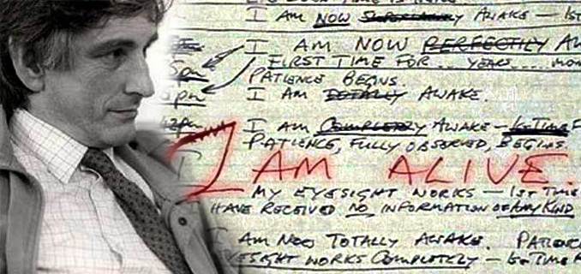
Clive Waring has retrograde amnesia- he’s lost many memories
& he has anterograde amnesia - he can’t create new memories
His hippocampus is damaged which means he can’t transfer memory from his short term memory to his long term storage

Slide 47
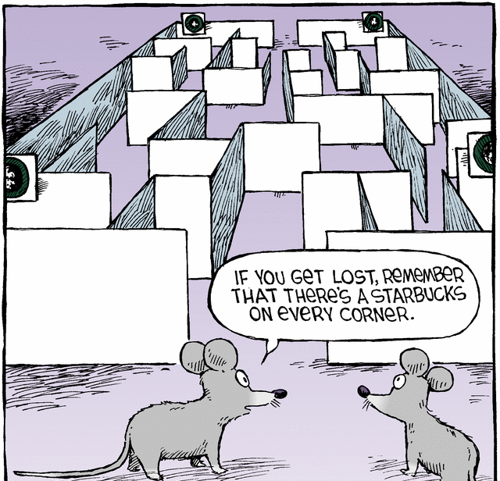
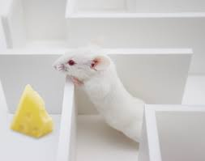
Theory (#2 of 6) Matt Wilson, MIT Center for Learning and Memory Dreams Create Wisdom
“Sleep turns a flood of daily information into what we call wisdom:
the stuff that makes us smart for when we come across future decisions”
we encode memory to long-term memory when we sleep
Dreams sort through memories, to determine which
ones to retain and which to lose.
His test: He put rats in mazes during the day & recorded what neurons fired in what patterns as the rats negotiated the maze. In REM sleep, the same neuron patterns fired that had fired at important turning points in the maze.
In other words, he saw that the rats were dreaming of important junctures in their day.

Slide 48
How does the brain choose what memory to consolidate?
“TAGS”
If not tagged, sleep will forget memories it decides you don’t need
How to make sleep cement a memory?
For example: If you think you will be tested, your brain will remember it
Tags might be:
emotional
you were excited about it
pleasurable
made you happy
When does sleep consolidate memory?
In stage 3 and 4 deep slow-wave sleep (Non-rem sleep)

Slide 49
Sleep is important for memory
sleep before learning, is necessary because it prepares you to learn
the next day
sleep after learning is essential: it grabs onto the new information and cements the information in the neural architecture of the brain.
Sleep is like a save button, protects the memory and strengthens memory
Sleep intelligently cross links large sets of information, seeks out patterns, rules of all that information and creates novel insights.
Problem solving (the expression: sleep on it)
If sleep deprived, about 40% impairment in capacity to learn

Slide 50
MEMORY TRIAGE: (Acquisition | consolidation)
While we sleep our brain processes new information in a discriminatory manner
it picks and chooses what to keep
assimilates the memory into a
vast library of evolving knowledge
Encoding and Sleep Consolidation
Not everything is remembered-
For information that is retained, sleep integrates it into existing memory by:
looks for common patterns
Consolidates memories
Or, simply cement and strengthen the memory exactly as it was learned

Slide 51
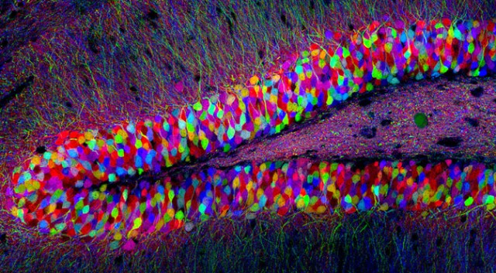
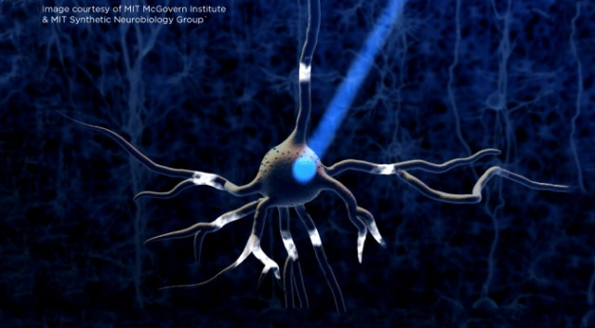
NEURONS: The Location of Memory
Memories are Physical: Not conceptual
When we have a new memory the gene Npas4, discovered at MIT, activates, turns on other
genes and changes the brain wiring
100+ genes control the formation of memories
A memory (engrams) can’t be erased
Neurons in the Hippocampus
Using Optogenetics
(light is used to control neurons)
Without the gene Npas4 we cannot form memories
Center for Neural Circuit Genetics at the Picower Institute for Learning and Memory at MIT
Notes:
New discovery: a different group of genes is used in memory processing than genes that are involved when the brain is in a resting state. Many of these had not previously been linked to any brain process
When you experience a new event, your brain encodes a memory of it by altering the connections between neurons. This requires turning on many genes in those neurons. Now, MIT neuroscientists have identified what may be a master gene that controls this complex process.

Slide 52
Dream Theory # 1 The Evolutionary Theory We Dream to Practice Response to Situations Antti Revonsuo
Activity of the amygdala increases
The brain fires as if it’s in a
real life situation
The brain activity for motor skills increases- firing in a way that it’s practicing motor skills like running or jumping
In the safety of night, we practice survival skills
We rehearse fight or flight situations

Slide 53
The attention span of a goldfish
Who has a longer attention span?
A typical person or a tech-savie person or a goldfish?
Notes:
http://medicalxpress.com/news/2015-05-microsoft-human-attention-span-lags.html
In analyzing the data obtained, the researchers found that the average attention span for the respondents and volunteers was just eight seconds, down from twelve back in 2000, and one second shorter than the average goldfish. They also found that using digital devices has caused an improvement in multi-tasking skills.
there are three types of human attention:
sustained (prolonged focus),
selective (maintaining focus despite distractions)
alternating (shifting attention between tasks or stimuli).

Slide 54
OUR COLLECTIVE MEMORY
Three memories
1 flashbulb memory (explicit and specific)
1 semantics/ not important
1 procedural (implicit and general)

Slide 55
Calvin Hall: Dreams are a cognitive process
The goal is not to understand the dream-
But to understand the dreamer
Analyzed thousands of dreams from diaries
Developed a quantitative coding system for content
Looked for patterns
Methodical, empirical
Believed meaningful predictions could be made about
dreamer’s behavior and lifestyle
Dreams provide a path to the unconscious areas of the mind,
and can be a map for the dreamer to anticipate difficulties and obstacles

Slide 56
One picture is worth a thousand words
A dream is a work of art
Metaphor isn’t necessarily a metaphor
It can be a pun or a slang
He didn’t think dreams were a disguise
not hidden expression
Dreams provide a path to the unconscious areas of the mind,
and can be a map for the dreamer to anticipate difficulties and obstacles

Slide 57
For more information | class one and Two:
Black Elk
His book: https://en.wikipedia.org/wiki/Black_Elk_Speaks
https://en.wikipedia.org/wiki/Black_Elk
Descartes Three Dreams:
http://physics.weber.edu/carroll/honors/descarte.htm
Dr. Gazziniga: Split brain research
http://www.informationphilosopher.com/solutions/scientists/gazzaniga/
Dr. Gazzinga and Alan Alda -Brains work independently
https://www.youtube.com/watch?v=lfGwsAdS9Dc
The Interpreter Within: The Glue of Conscious Experience
http://www.dana.org/Cerebrum/Default.aspx?id=39343
Dr. Ganziga, split-brain research
http://www.nytimes.com/2011/11/01/science/telling-the-story-of-the-brains-cacophony-of-competing-voices.html?pagewanted=all
Video: http://www.nytimes.com/video/science/100000001142409/michael-gazzaniga.html
http://bigthink.com/users/michaelgazzaniga

Slide 58
For more information | class one and Two:
Split Brain Experiments and Information:
http://www.medclip.com/index.php?page=videos&section=view&vid_id=103271
Psychology Today: http://www.psychologytoday.com/blog/the-superhuman-mind/201211/split-brains
Cal Tech: http://www.its.caltech.edu/~jbogen/text/ref130.htm
Split Brain, Split Mind: http://brainmind.com/Brain3.html
Michael Gazzaniga http://www.nytimes.com/2011/11/01/science/telling-the-story-of-the-brains-cacophony-of-competing-voices.html?pagewanted=all&_r=0
Big Think: 3 videos- http://bigthink.com/users/michaelgazzaniga
The Criminal Brain. Your Brain is Automatic. You are Free & Your Storytelling Brain
Legal Responsibility
Center for Law, Brain and Behavior http://clbb.mgh.harvard.edu/criminal-responsibility/
COMA
Coma Patients: http://www.medpagetoday.com/Neurology/HeadTrauma/40947
Do Brain Scans of Comatose Patients Reveal a Conscious State?
http://www.scientificamerican.com/article/do-brain-scans-comatose-patients-reveal-conscious-state/
See Monkey, See monkey Do: Mirror Neuron Research
http://www.psychologicalscience.org/index.php/news/releases/monkey-see-monkey-do-the-role-of-mirror-neurons-in-human-behavior.html
See Monkey, See Monkey Do
http://www.pbs.org/wgbh/nova/education/body/mirror-neurons.html
Mirror Neurons and Intention
http://www.youtube.com/watch?v=Tq1-ZxV9Dc4
Memory and Genes http://news.mit.edu/2011/hippocampus-memory-genes-1222

Slide 59
MUSIC for listening
Free falling john mayer live (great 4 minutes 10 sec, com)
http://www.youtube.com/watch?v=20Ov0cDPZy8
Learning to Fly live : 5 minutes http://www.youtube.com/watch?v=4p_f7Df2-oM&feature=related sky sailing Brielle 4. minutes http://www.youtube.com/watch?v=_PkzsMak6P8&ob=nb_av2e
Sleepsong- lord of the rings
http://www.youtube.com/watch?v=VjbCp7w5Oww

Slide 60
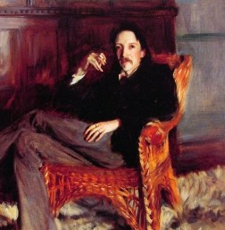
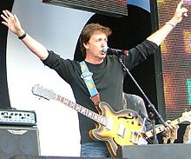

Slide 62
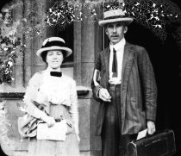
Sir Arthur tansley
A BOTONIST, who later became a psychologist
famous for the idea that ecosystems are self-organizing

